Slide 1
Lecture 17 Graph-Based Algorithms
CSE373: Design and Analysis of Algorithms

Slide 2
Bipartite Matching
A bipartite graph is an undirected graph G=(V, E) in which V can be partitioned into two (disjoint) sets V₁ and V₂ such that (u, v) ∈ E implies either u ∈ V₁ and v ∈ V₂ or vice versa.
That is, all edges go between the two sets V₁ and V₂ but are not allowed within V₁(blue) or within V₂(yellow).
A
X
B
Y
C
Z
D

Slide 3

Bipartite Matching
Example
An organization with $n$ jobs and $m$ potential candidates
Assume we have a way to determine which pairs (job/candidate) are compatible
E.g. (Joe, mailman) or (Fred, accountant) but not (Frank, accountant)
Problem: Maximize the number of assignments
A maximum (or maximum cardinality) matching is a matching with the largest number of edges
always exists
not always unique
V
1
2
3
4
5
6
U
7
8
9
10
11
12

Slide 4
Bipartite Matching
Matching (not maximum)

Slide 5
Bipartite Matching
A maximum matching

Slide 6
Bipartite Matching
Another maximum matching

Slide 7
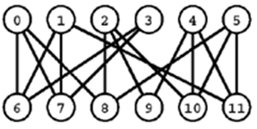
Bipartite Matching
Problem:
Given a bipartite graph, find a set of edges of maximum cardinality such that each vertex is connected to at most one other vertex.

Slide 8
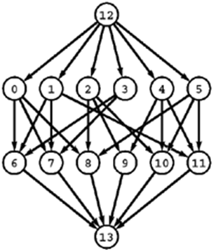
Bipartite Matching
Reduction: Construct an ST-network
by directing all the edges from the one set to the other,
adding a new source with edges to each vertex in the first set,
adding a new sink with edges from each vertex in the second set, and
assigning equal capacity to all edges.
A solution to the maximum-flow problem on this network gives a maximum matching for the bipartite graph.

Slide 9
Example

Slide 10
Example

Slide 11
Example

Slide 12
Example

Slide 13
Example

Slide 14
Example

Slide 15
Example

Slide 16
Example

Slide 17
Example

Slide 18
Example

Slide 19
Example - alternate

Slide 20
Example - alternate

Slide 21
Example - alternate

Slide 22
Example - alternate

Slide 23
Example - alternate

Slide 24
Example - alternate

Slide 25
Example - alternate

Slide 26
Example - alternate

Slide 27
Example - alternate

Slide 28
Example - alternate

